Slide 1
Fivetran HVR Training
v1.3
Last updated: 03/18/25
Security

Slide 2
Security
User Authentication
Local Authentication
PAM Authentication
Plugin Authentication
Kerberos Authentication
Windows Authentication
User Permissions
Repository level permissions
Hub level permissions
Classification of Data
Encryption
Encryption in transit Encryption at rest
Managed Secrets
This module describes the elements and principles of security architecture in Fivetran HVR

Slide 3
User Authentication
Hub and agent user authentication methods

Slide 4

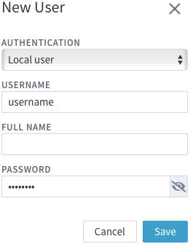
Local Authentication
Hub user
Windows
Agent user
Linux
HVR uses local user accounts that are created in the HVR system and are stored in the repository database of the hub server.
Users who provide local user credentials are authenticated locally on the HVR hub server.
This is the default authentication mode of HVR.

Slide 5

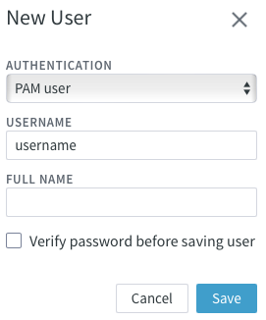
Pluggable Authentication Module (PAM)
Hub user
Windows
Agent user
Linux
PAM is a login/password authentication service used to validate user credentials on Unix and Linux systems as an alternative to regular username/password authentication.
The default PAM authentication service is ‘login’.

Slide 6
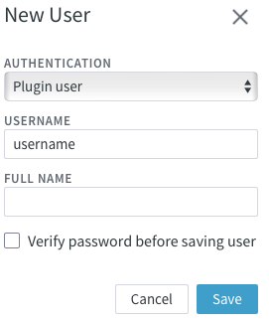
Plugin Authentication
Hub user
Windows
Agent user
Linux
HVR allows users to supply their own plugin for authentication
The custom plugin file must be named as hvrauth and saved in the directory $HVR_CONFIG/plugin/authentication.
The plugin must follow simple call conventions:
It should read a two-line input that contains a username and password
It should exit with code 0 if the username and password are valid.
Otherwise, it should exit with code 1.

Slide 7
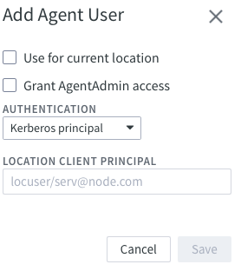
Kerberos Authentication
Hub user
Windows
Agent user
Linux
To use this authentication method, Kerberos must be already configured in the user machine/network.
This authentication method is applicable only for authenticating the agent user on Linux and Solaris systems. Moreover, this authentication is supported only when the HVR hub server is running on Linux.

Slide 8
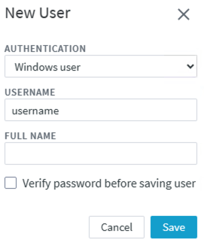
Windows Authentication
Hub user
Windows
Agent user
Linux
The user is authenticated using a username and password of the Windows user available in the Active Directory (AD).
In this authentication method, HVR uses the Windows user account to authenticate a user.

Slide 9
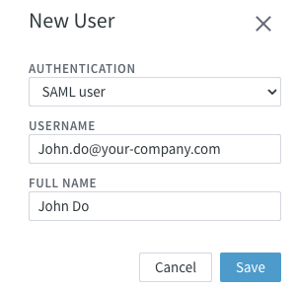
SSO Authentication
Hub user
Windows
Agent user
Linux
SSO is a session and user authentication method that lets you securely access multiple applications and services using one set of credentials.
We use SAML authentication to configure SSO.
The following identity providers are supported:
Google Workspace
Microsoft Entra ID
Okta
Only available in HVR 6.2.5/2 (early adopter)

Slide 10
True or False? Users created with local authentication are operating system users.
False.
Local users exist only in HVR.

Slide 11
User Permissions
Repository and hub level permissions

Slide 12




Repository Level Permissions
SysAdmin
HubCreation
ReadMetering
Full access to the system, including all hubs and users. The SysAdmin has permissions for all operations and can manage all resources and users in the HVR Hub System.
Create new hub(s) in the HVR Hub System.
Extract Monthly Active Rows (MAR) consumption/metered usage data of the HVR Hub System.

Slide 13
Hub Level Permissions (HVR 6.1.0)
This permission level defines what a user is allowed to do within a specific hub.
Role | View definitions | Change definitions | Perform Refresh | Perform Compare | Start/stop jobs | Change access and properties
HubOwner
ReadWrite
ReadExecRefresh
ReadExec
ReadOnly

Slide 14
Hub Level Permissions (HVR 6.2.0)
This permission level defines what a user is allowed to do within a specific hub.
Role | View definitions | Change channel definitions | Change location definitions | Perform Refresh | Perform Compare | Start/stop jobs | Change access and properties
HubOwner
ReadWrite (Channels and Locs)
ReadWrite (Channels)
ReadWrite (Locations)
ReadExecRefresh
ReadExec
ReadOnly

Slide 15
Classification of Data
Logical classification of data/information

Slide 16




Classification of Data
Based on sensitivity
Secret
Confidential
Unclassified
Public
This category includes passwords and private keys used to access/connect to a database or technology.
This category includes user data (e.g. key values) exposed in error messages, and files such as transaction files, diff files, intermediate files
This includes column names, timestamps, change metadata, replication statistics, hostnames, fingerprints, and license hashes.
Data available to the public. This category includes Fivetran HVR distribution binaries and product documentation.

Slide 17
True or False? Transaction files are classified as Confidential data.
True.

Slide 18
Encryption
Encryption in transit and at rest

Slide 19
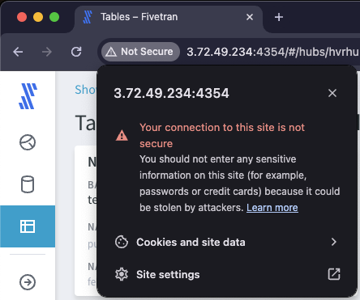
TLS 1.3 secured communication between hub and browser
1
2
Create a cert folder under $HVR_CONFIG/etc. Place a private key (hvrhubserver.priv_key) and a public cert (hvrhubserver.pub_cert) in the new cert folder.
Set HTTPS port by running hvrhubserverconfig HTTPS_Port=4341. Disable the HTTP port by running hvrhubserverconfig HTTP= (optional)
3
4
If the private key is protected with a password, run hvrhubserverconfig HTTPS_Private_Key_Password= @prompt
Restart the hvrhubserver process/service.

Slide 20



TLS 1.3 secured communication between the hub and agent(s)
The communication between the agent and hub machine is encrypted by default. The key pair is saved on the agent: $HVR_CONFIG/etc/hvragent.conf.
The key pair is automatically generated on the agent machine. It can be replaced with a custom key pair supplied by the user or with one generated by the hvrsslgen CLI command.
In case of a multi-node cluster, the agent configuration must be done on one machine and the resulting hvragent.conf file on this node must be copied over to the rest of the nodes.
The agent’s public certificate is discovered by the hub on the first connection to the agent and saved as a location property.
Notes:
Talk about why we do this (counter packet sniffing, man in the middle attacks).

Slide 21
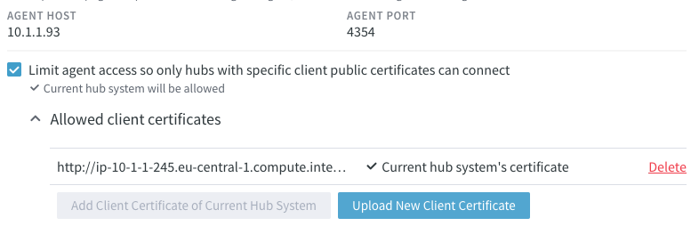




Limit agent access from hubs
By default, the agent can be accessed by all hub systems.
Allow only certain hub systems to access the agent service by using the client public certificate of the hub system.
Selecting this option enables anonymous connections from the specified hub system(s) to the agent so then the hub system can connect to the agent without using the agent user credentials.

Slide 22


TLS Configuration
6
Hub’s pub cert transferred to agent (optional)
Agent key pair generated
3
First configuration connection initiated
1
2
Setup window started
HVR Agent
HVR HUB
5
Agent’s cert is saved in properties
7
Hub’s cert is saved in config (optional)
8
Setup mode is terminated (optional)
Agent’s public certificate discovered
4

Slide 23



Secured data transfer
Oracle
Snowflake
1
Change captured
Change integrated
7
4
Data decrypted by hub
HVA Listener
HVR HUB
HVA Listener
2
Data encrypted by agent
5
Data encrypted by hub
6
Data decrypted by agent
3
Hub is verified by agent (optional)
‹#›

Slide 24










Encryption at rest
Hub System Encryption Wallet
The Hub System Encryption Wallet is an advanced method for secure password encryption and storage.
If the wallet is not configured and enabled, all passwords are obfuscated, not encrypted.
When the wallet is enabled, by default, only the Secret data is encrypted.
To enable encryption of the Confidential data (e.g. TX files), use the command hvrhubconfig hub Encrypt_Transaction_Files=true
Whenever HVR needs the encryption key, it opens the wallet by supplying the wallet password and fetches the AES256 encryption key into the hub process’s memory.
The AES256 encryption key is never stored on the disk.
Notes:
PKCS12 wallet file + separate file

Slide 25
If the wallet is turned on during hub creation in the UI then the auto-generated wallet password is never exposed to the users.

Slide 26


Software wallet
Storing the wallet locally
Local file
Password
Wallet credential
The wallet is an encrypted (using PKCS #12 standard) and password-protected file, stored on the hub machine
The wallet password is auto-generated when the wallet is created
The wallet password is stored obfuscated in a wallet credential file in $HVR_CONFIG/wallet

Slide 27



KMS wallet
Amazon integration in HVR
Cloud service
Protection
Communication
In this case, the wallet is a network service, AWS KMS, that stores and encrypts the encryption key
The KMS wallet is protected either by AWS KMS credentials or the AWS IAM role, which should be supplied by the user while creating the KMS wallet.
When the wallet is created, HVR contacts KMS, which generates a key and sends it back to HVR and HVR stores it in the wallet configuration

Slide 28
True or False? Data transfer between the agent and hub machine is always secured by TLS.
True.

Slide 29
True or False? The Hub System Wallet encrypts both Secret and Confidential data by default.
False.
Only Secrets are encrypted by default.

Slide 30
Managed Secrets
Utilising external password managers

Slide 31
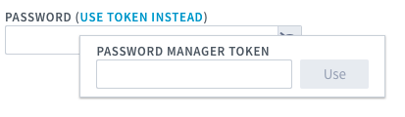






Managed Secrets
Utilizing external password managers.
Available in GA, starting from 6.2.0/0.
Enhances security by keeping secrets in a secure environment, external to HVR. Simplifies management when secrets rotate frequently.
HVR automatically receives the latest password from the password manager based on the stored token.
To configure Managed Secrets, create a script called hvrmanagedpassword in $HVR_CONFIG/plugin/authentication
The script must contain logic that contacts the external manager using the stored token coming from standard output and then print the password sent back by the manager to stdout.
The Hub_Server_Password_Manager_ Configured hub server property automatically switches to true and option ‘USE TOKEN INSTEAD’ is displayed in UI fields designated for entering secrets when the hvrmanagedpassword script file is detected.

Slide 32
Key Learnings
1
Explored the different authentication methods for agent/hub users.
Learned about the user permission models.
Learned how Fivetran classifies data in HVR.
Learned how HVR defends against packet sniffing and man-in-the-middle attacks.
Learned how to encrypt passwords in the hub repo.
Learned how to encrypt files on the hub machine, and how to fetch passwords from external vaults.
2
3
4
5
6

Slide 33
Q&A

